Slide 1
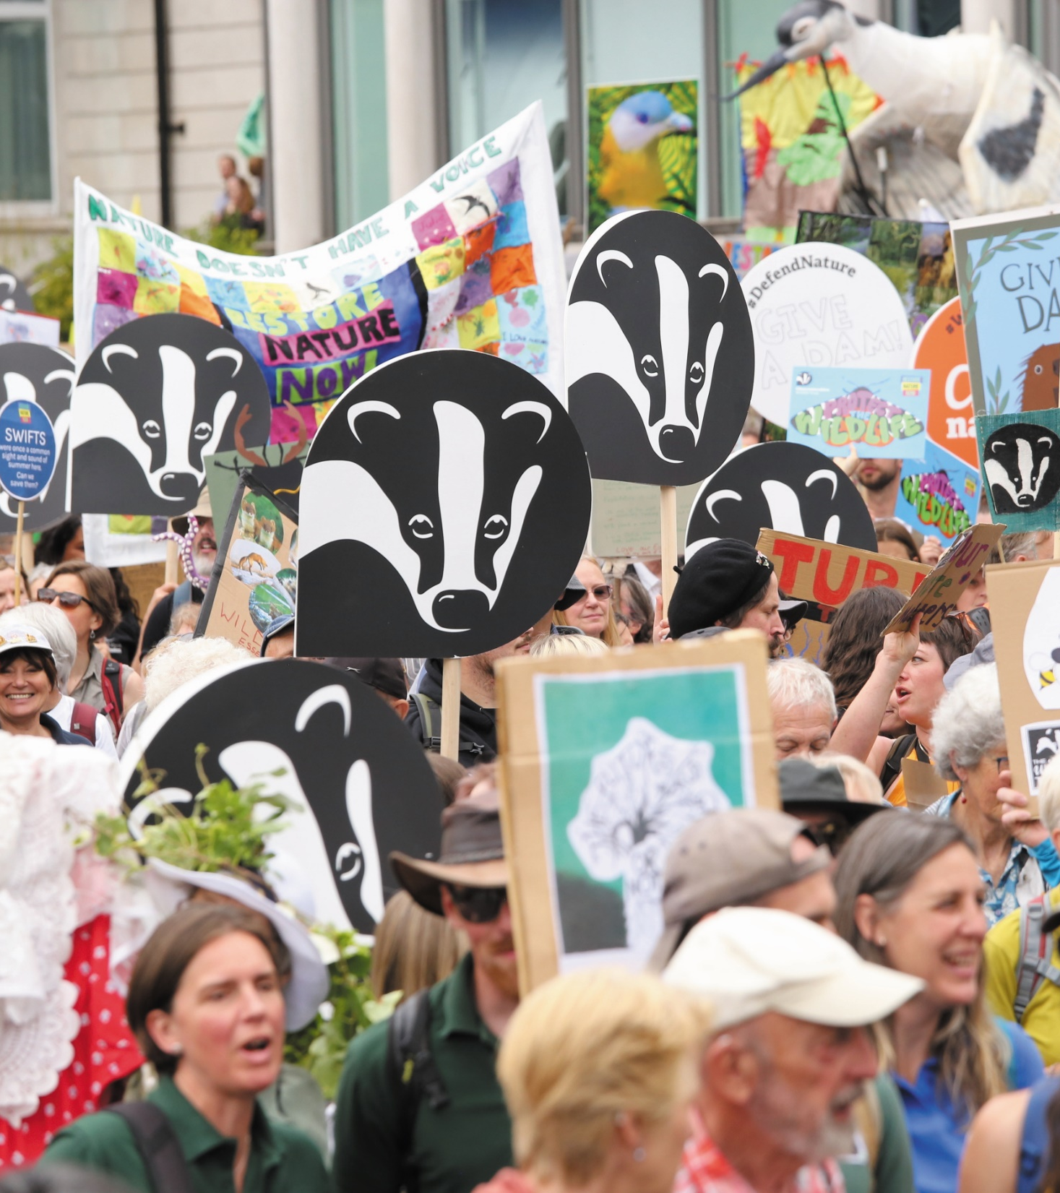

#TeamWilder:
Regional
Community Organiser
Job Pack
Tom Simone
Steve Cheshire

Slide 2
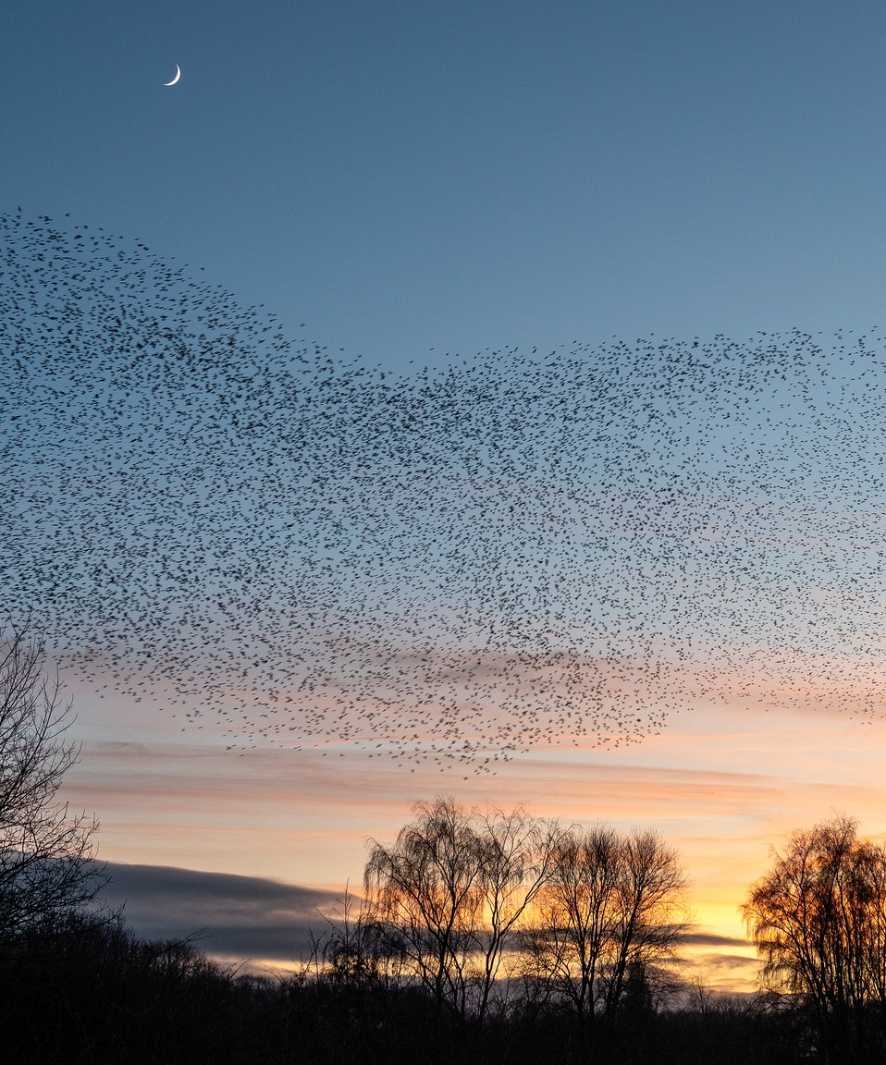
Welcome
Thank you for your interest in a role at Warwickshire Wildlife Trust
Warwickshire Wildlife Trust has an ambitious ten-year strategy. By 2030 we want to have put wildlife back into recovery by creating more space for nature with more people on nature’s side.
The 2023 State of Nature Report highlighted the continuing
devastating loss of UK nature. One in six species are at risk of
becoming extinct in Great Britain, whilst widespread animals and plants such as swifts, hedgehogs, and chamomile are becoming rarer. Our wildlife is slipping through our fingers.
We must act fast, with ambition, and at scale. Warwickshire Wildlife Trust is here to put nature into recovery, and we need your help. By joining our organisation, you will be making a unique contribution to an incredible mission. People are at the heart of everything we do here, and you can view the many benefits offered to Warwickshire Wildlife Trust staff in this
pack.
We look forward to receiving your application.
Ed Green, CEO of Warwickshire Wildlife Trust
WKWT

Slide 3
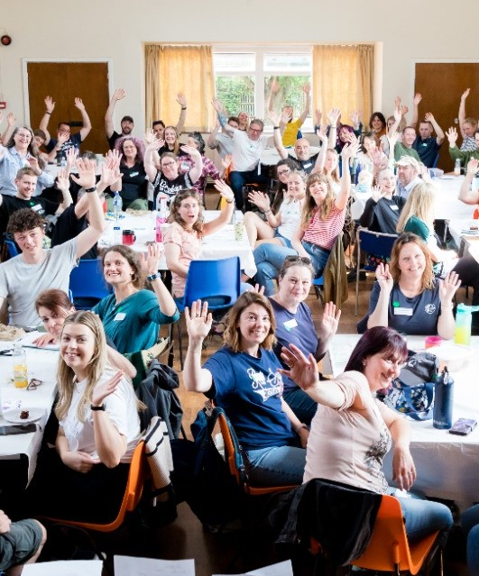
Who are we?
Warwickshire Wildlife Trust is one of the 46 UK Wildlife Trusts. Established in 1970, we are a grass roots organisation governed by 14 trustees elected from a membership of 28,000 people, 99% of whom live in the county, and supported by 700 active volunteers.
We manage an estate covering 1,000 hectares in Warwickshire, Coventry and Solihull and no one living or working in that area is more than 6 miles from one of our 67 nature reserves.
As members of the influential network of Wildlife Trusts, we are part of a collective covering the whole of the UK with 900,000 members, 32,500 volunteers, 2,500 staff and 600 trustees, all working together through a central unit, the Royal Society of Wildlife Trusts (TWT).
We believe everyone, everywhere, should have access to nature and the joy and health benefits it brings. Each Wildlife Trust is an independent charity formed by people getting together to make a positive difference for wildlife, climate and future generations.
Together we are on a mission to restore a third of the UK’s wildlife and nature by 2030.
Click here to read our 2030 Strategy
WKWT

Slide 4
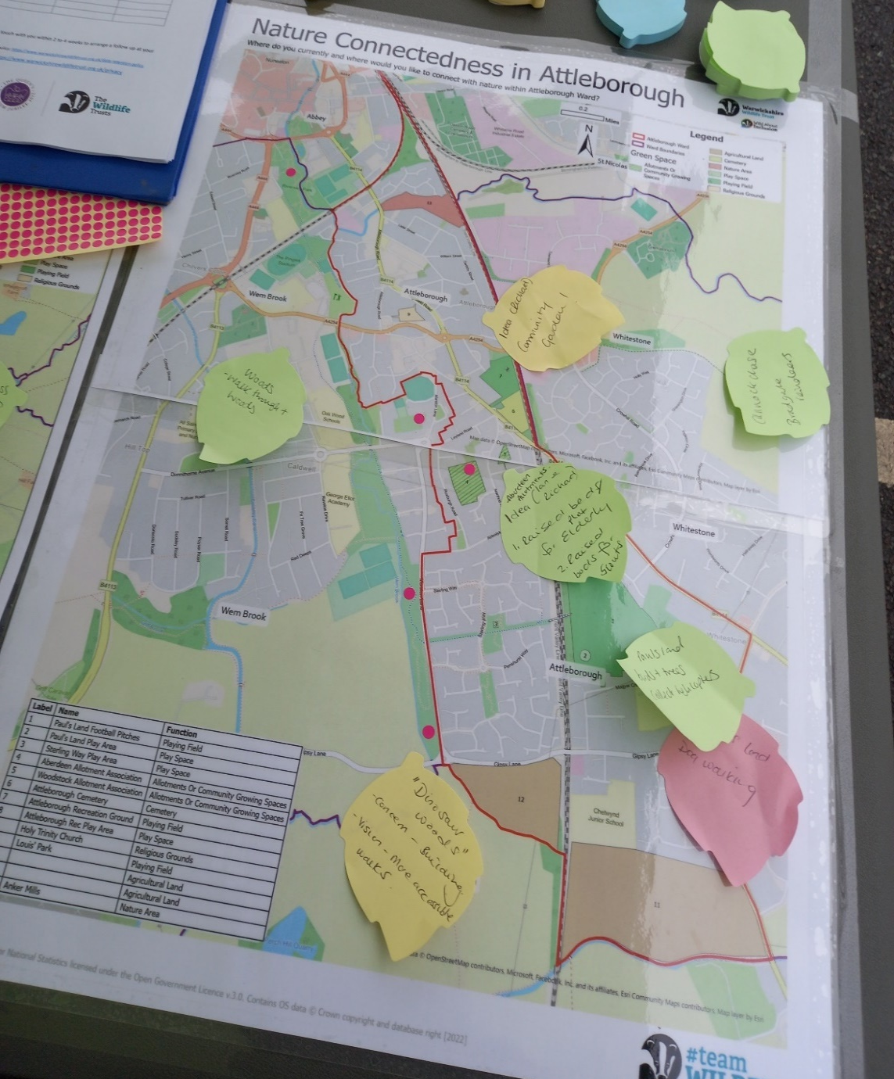
Our approach
Our Vision: A thriving natural world where wildlife plays a
valued role in addressing the climate, ecological and human
health emergencies and people are inspired to get involved in natures recovery.
Our Purpose: To bring wildlife back, to empower people act for
Nature and create an inclusive society where nature matters.
Our Approach: We speak with a bold and confident voice, telling the truth about the state of nature and what needs to be done to put it in recovery.
As part of a grassroots movement, we are firmly rooted in our local communities where we look after wild places and increase people’s experience of the natural world.
We look to establish common cause and work in partnership with others, to develop new, innovative ways to do what’s right for nature and deliver impact in support of our vision.
We demonstrate what is possible and inspire and enable people from all backgrounds to bring about our vision with us, embracing diversity in our society to change the natural world for the better.
As part of the UK network of Wildlife Trusts we work to ensure that our local actions add up to have a collective impact.
WKWT

Slide 5
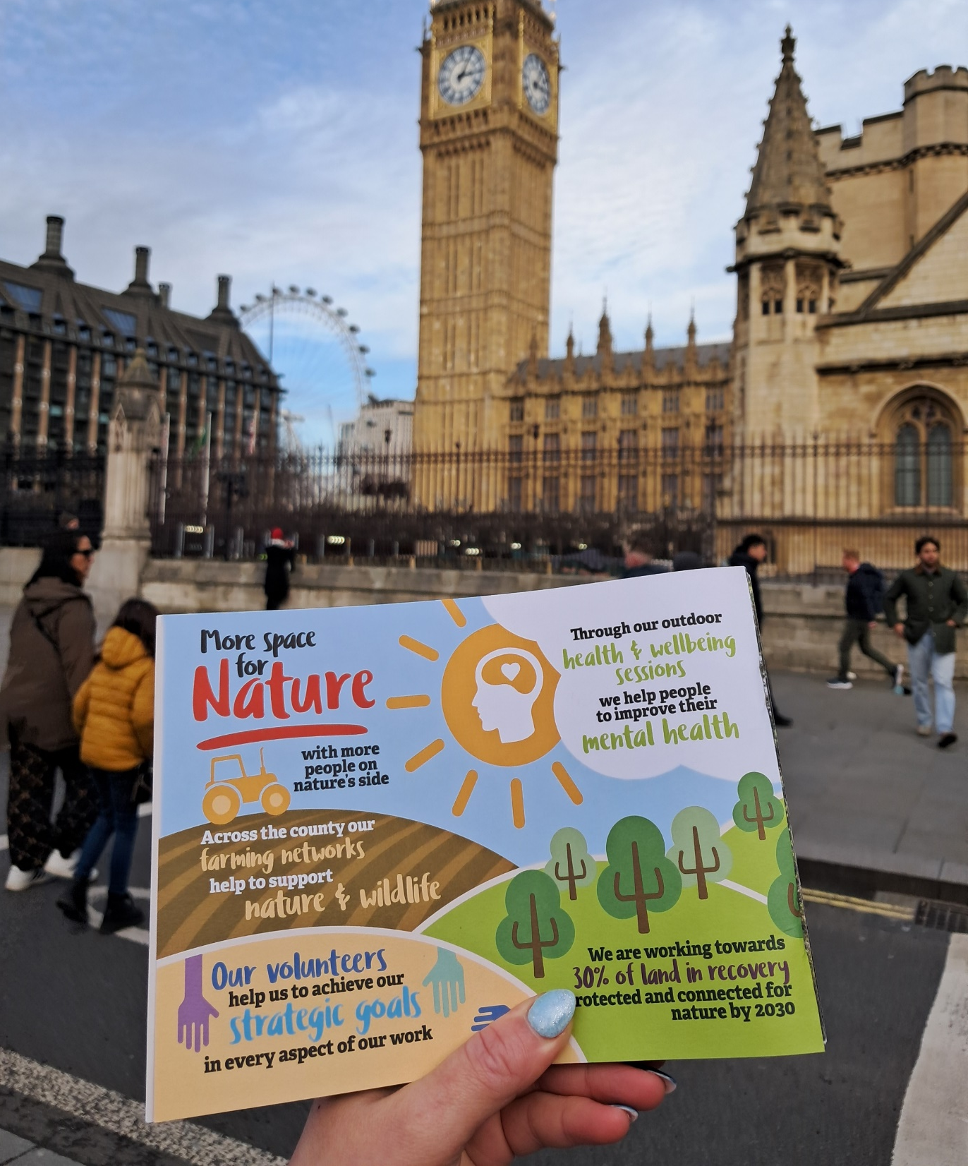
Empowering Communities
At Warwickshire Wildlife Trust, we believe real change happens from the ground up. If nature is to be restored at scale, many more people need to be on nature’s side. Leadership and mobilisation are key to building an inclusive society where nature matters and Wildlife Trusts, rooted in their communities, can act as powerful facilitators of change.
We will listen deeply to understand the motivations of different people and communities, respecting their personal relationship with nature. By showing empathy and learning what nature means to them, we can shape approaches that are open, inclusive, and led by supporters.
We will actively reach out to people of all ages, backgrounds, cultures, identities, and abilities. By listening and learning, we can understand the barriers that prevent people from connecting with nature, and work to remove them. Everyone should have the chance to experience nature first-hand and discover their own pathways into action.
Our transformative action will be to provide a platform that informs, connects, and supports communities in their efforts to restore nature. creating opportunities for people to step into leadership, organising, and campaigning.

Slide 6
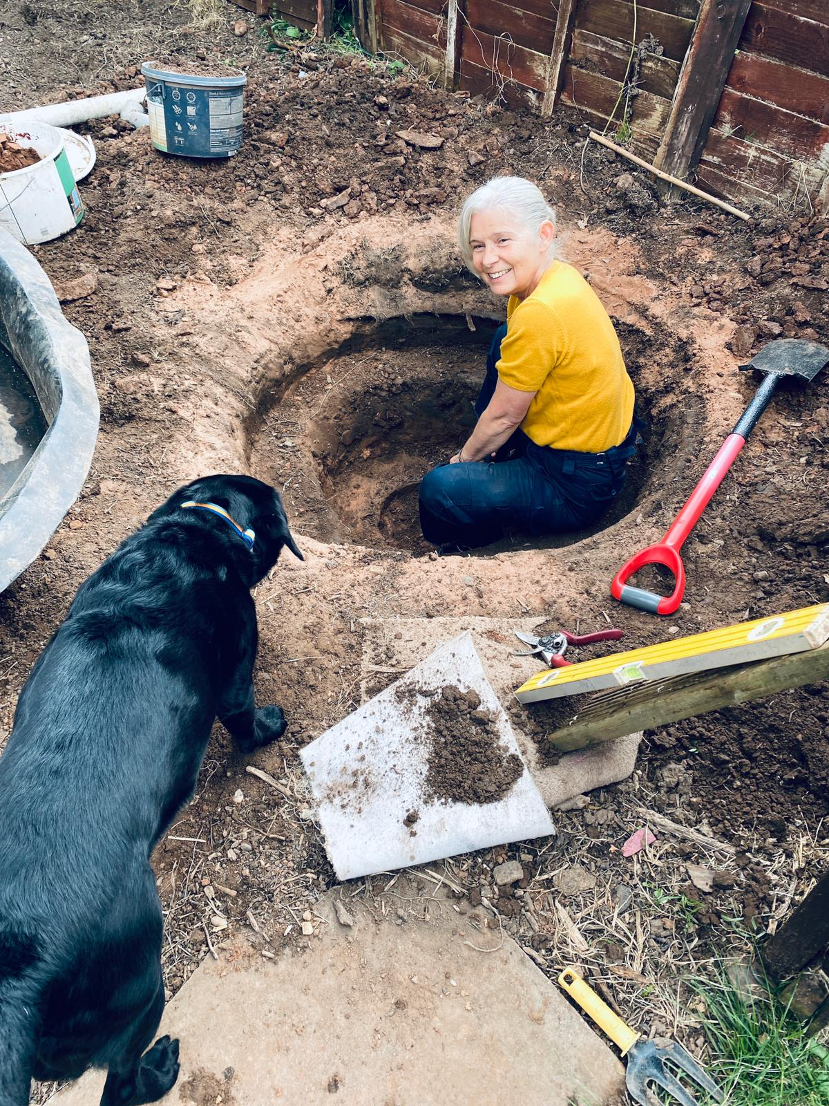
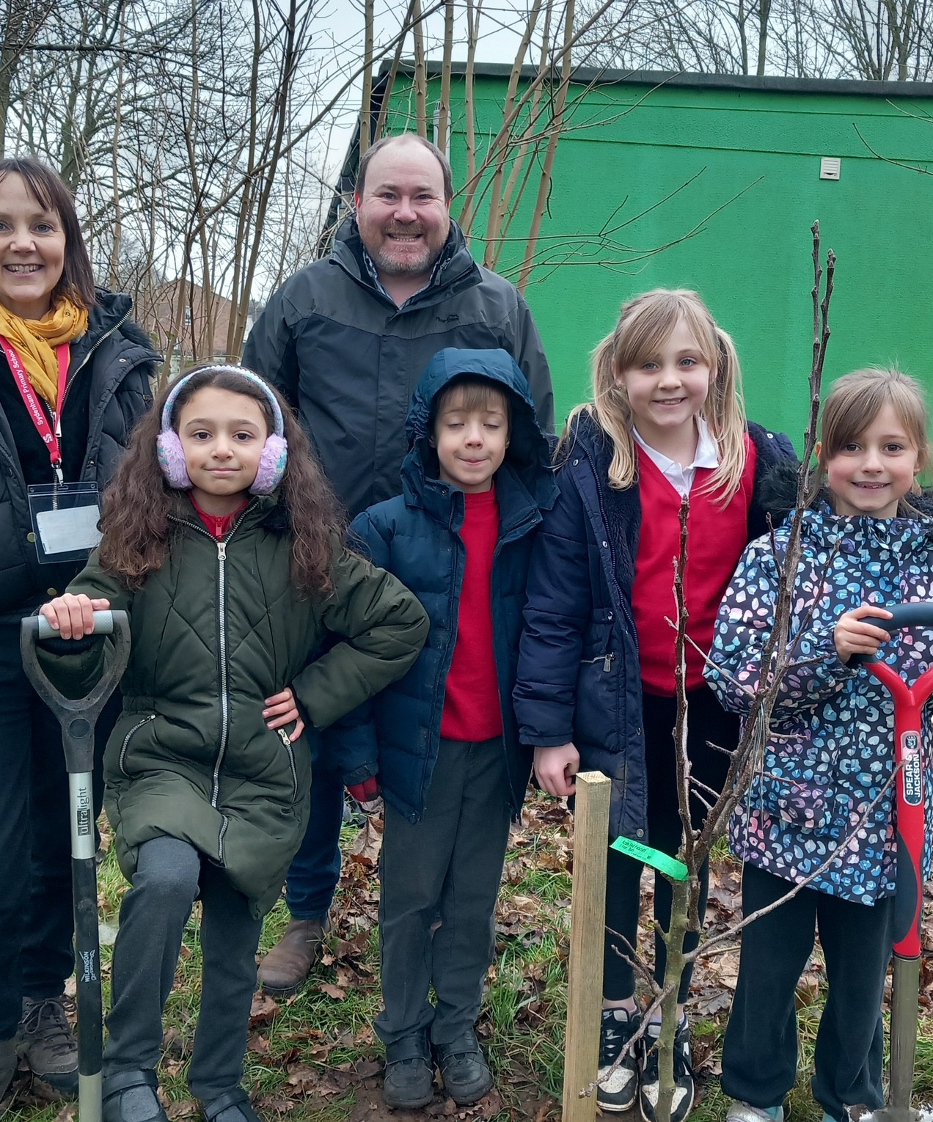
#teamWILDER
Team Wilder is our people-powered movement to get more people on natures side and putting nature into recovery. We can’t do this alone. It will take communities, leaders, volunteers, and supporters working together to achieve this.
Our organising team are building relationships, listening to communities, and supporting grassroots leaders to step forward. Alongside them, our newly formed enabling team provides the scaffolding: advice, citizen science, nature connection, that will help people take more meaningful action. Our communications and campaigns team amplify voices, connecting local stories to wider change and building public momentum.
To strengthen the Team Wilder movement in Warwickshire, we are developing a Team Wilder Academy, a pathway for training, leadership, and volunteering. From organisers and citizen scientists to connectors, mentors, advisors, and campaigners, the Academy will support people to learn, grow, and lead within their communities.
Together, these strands form the foundations of a growing movement, distributed, inclusive and led by people. By joining us, you will become part of shaping the future of Team Wilder and helping communities reclaim their power to restore nature.

Slide 7
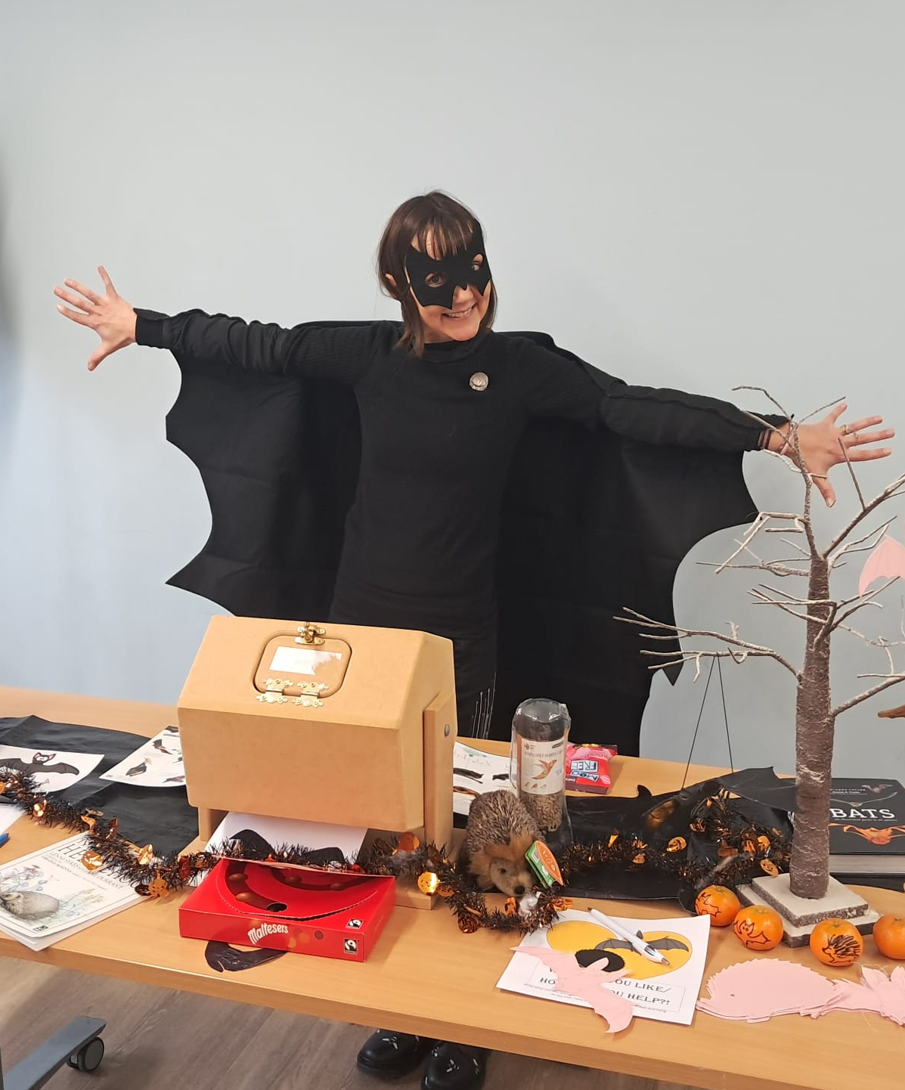
Community Organising Team
At the heart of the movement building is our organising team, organising to build power in communities and turn care for nature into action. We organise around places and people, starting with listening, building trust, and supporting leaders to step forward. From community-led campaigns on nature friendly housing developments, to hedgehog friendly neighbourhoods, to community groups reclaiming green spaces, our organisers are supporting communities to create meaningful change locally.
The organising team is led by our Community Organising Manager, with three grassroots organisers rooted in Nuneaton, Leamington, and Coventry. Each of the place-based organisers works locally, listening to residents, developing leaders, and building networks that connect people to each other and to nature. Alongside this, we are now recruiting two new broad-based roles; a Digital Community Organiser and a Regional Community Organiser. Weaving connections across places, strengthening local leadership, and helping to scale Team Wilder across the region.
Our organisers form a dynamic team with different specialisms — place-based, broad-based, and digital. Together they connect local action with wider networks, campaigns, and leadership pathways. This blend of approaches means we can grow at the grassroots, while also linking people into the wider movement.

Slide 8
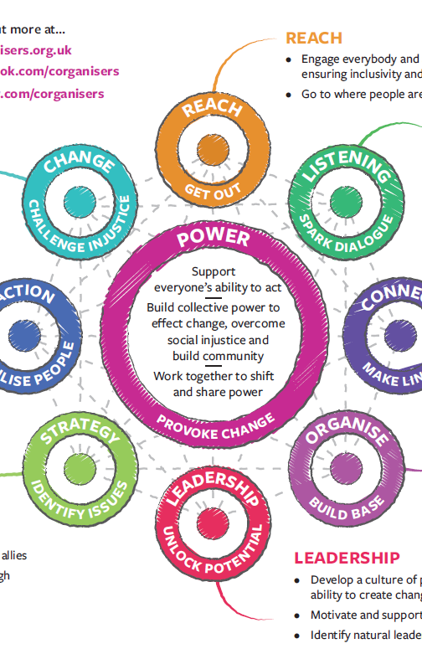
From Listening to Action
Our organisers follow the Community Organisers Ltd Framework, ensuring deep engagement and that helps people feel heard, supported and empowered to take action, leading to long-term change.
Reach: Meet people where they are at - doorsteps, cafés, events, or digital spaces.
Listen: Have meaningful 1:1 conversations to understand people’s experiences, hopes, and barriers
Connect: Bring people together around shared concerns, building trust and relationships
Organise: Support groups, action networks and campaign teams to form and grow.
Leadership: Develop community leadership and mentoring individuals to step up and take ownership
Strategy: Help communities set clear, achievable goals and action plans
Action: Support public actions, campaigns, and initiatives that help nature thrive
Change: Enable long-term transformational - from behaviour change and better access to nature to influencing policy and local decision making
Power: Help communities build collective power to challenge systems and have a stronger voice in shaping their future

Slide 9
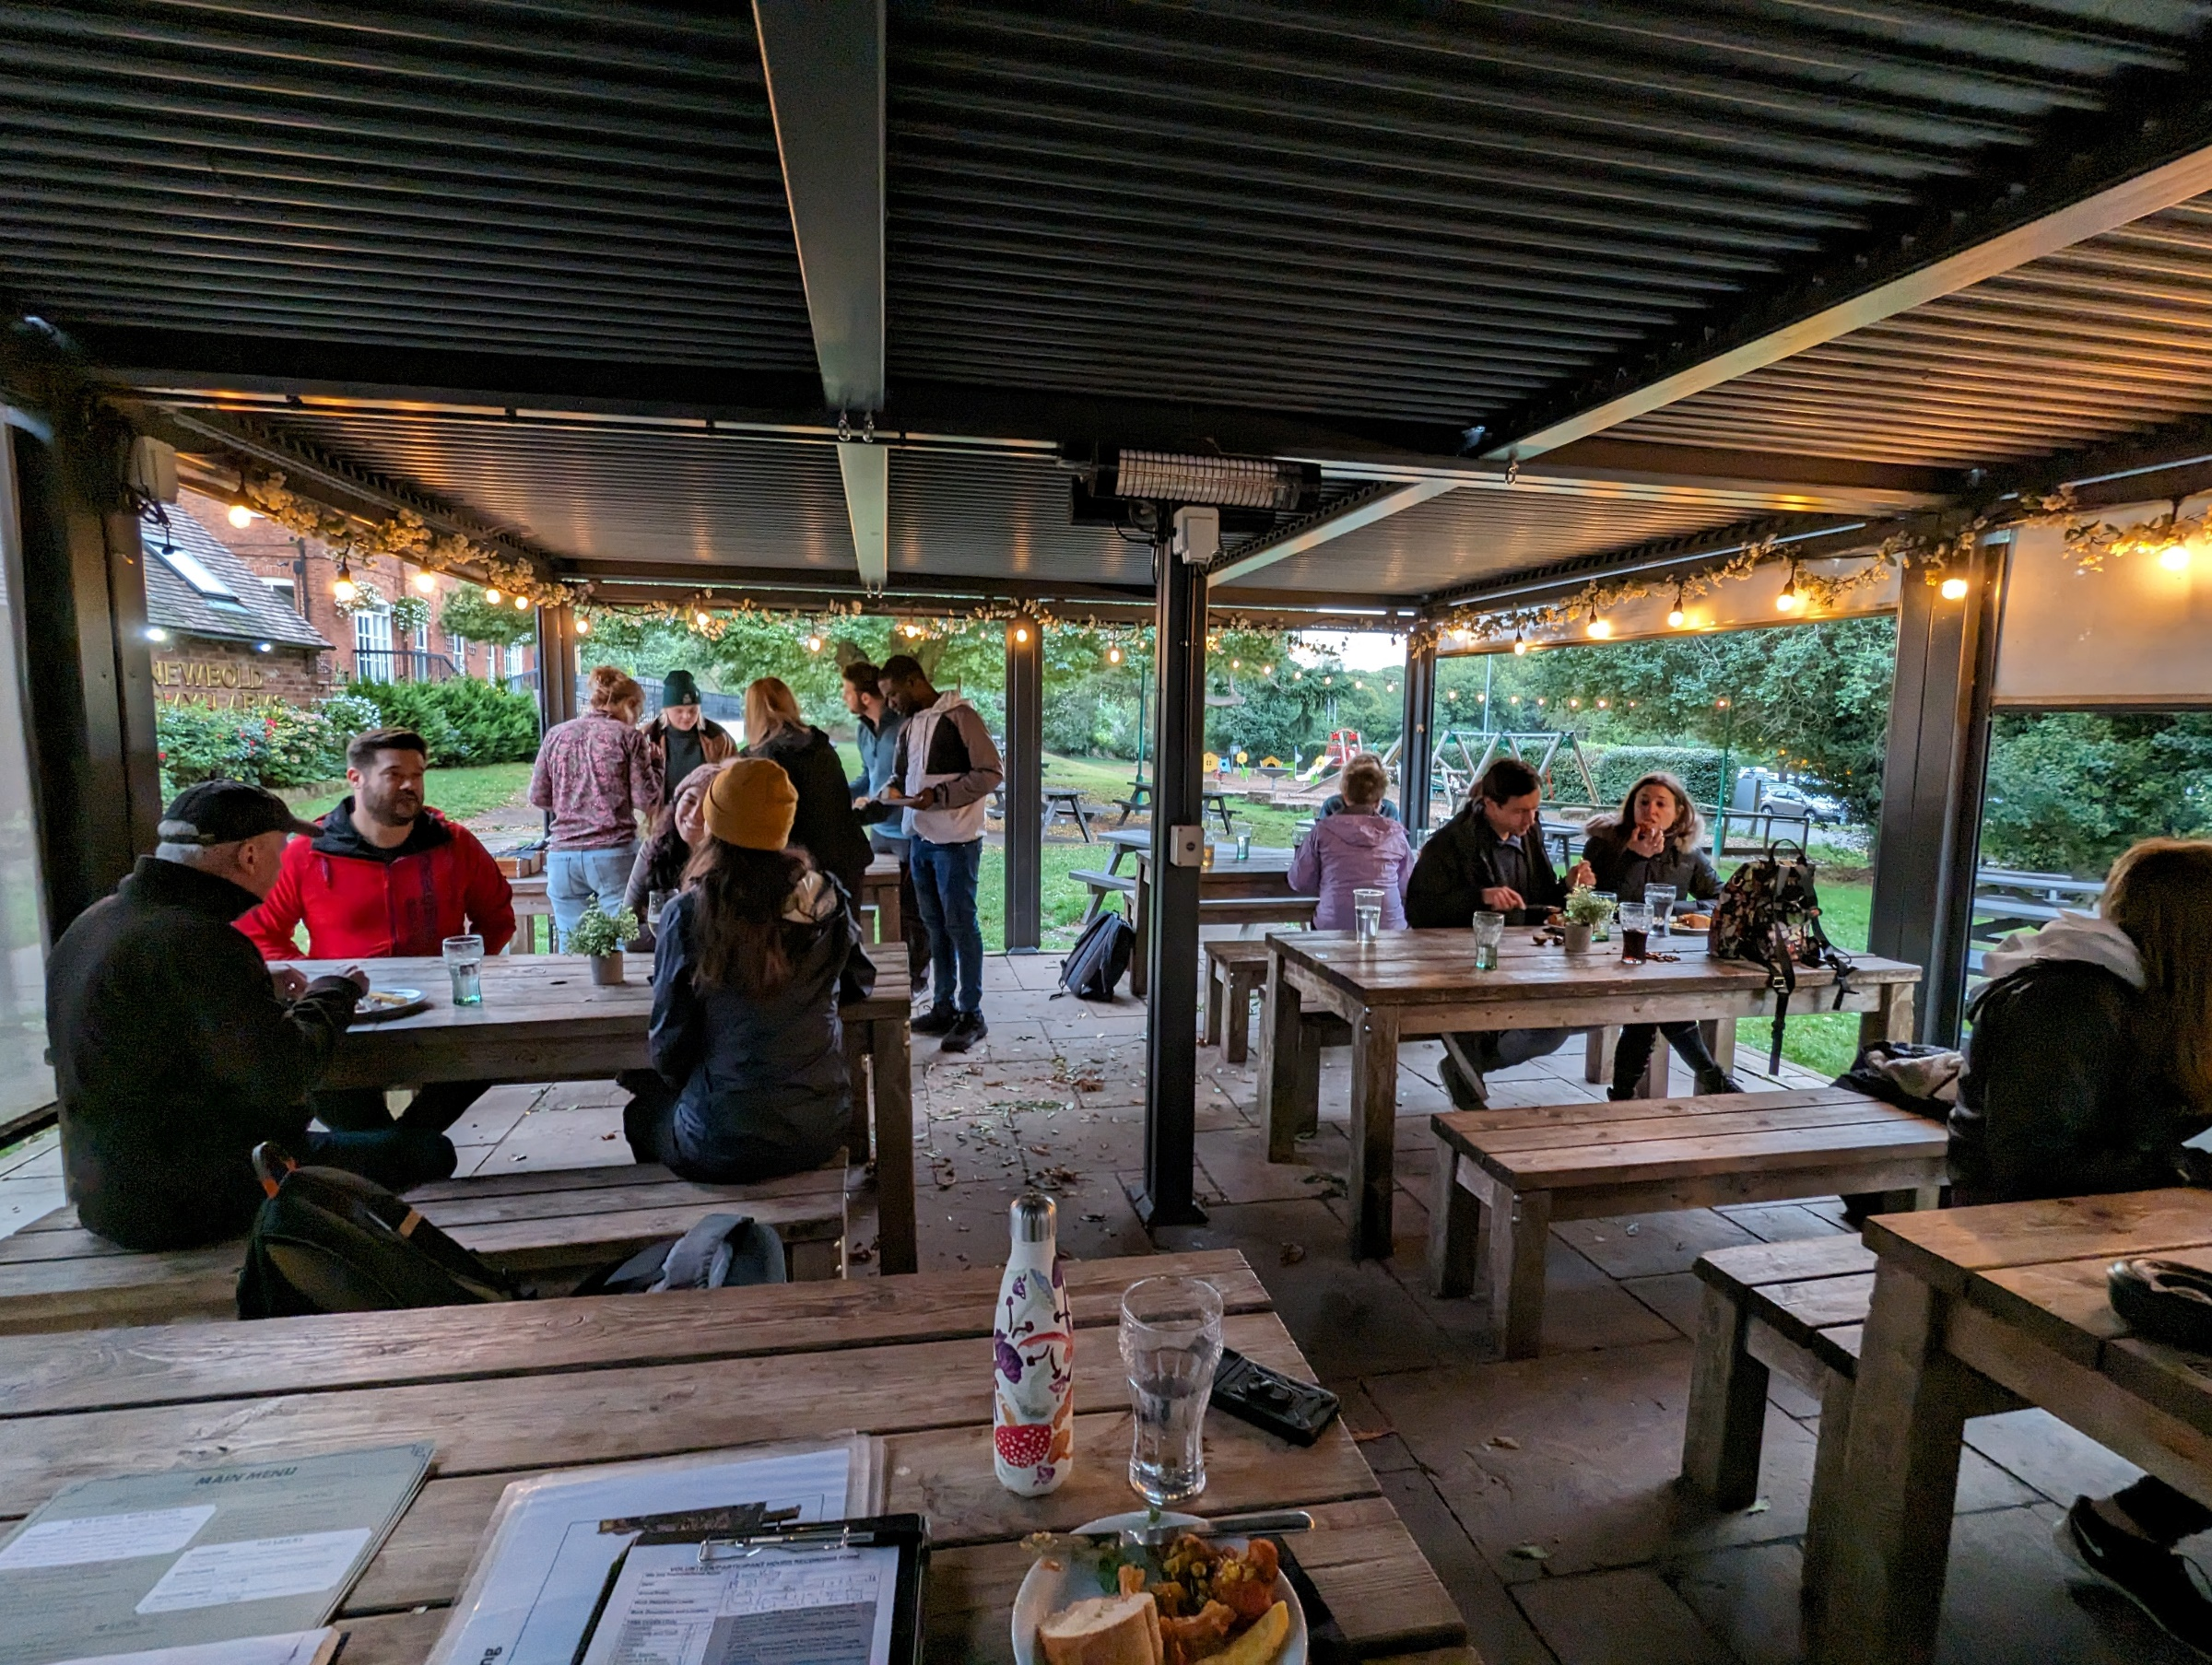
Regional Community Organiser
This role is part of our Wilder Organising team and focuses on building movement infrastructure across under-served or emerging areas of Warwickshire, with a particular emphasis on rural communities, villages, and new localities not yet covered by our place-based organisers.
The Regional Community Organiser will work across geographies to spark grassroots leadership, activate new local groups, and lay the foundations for long-term distributed organising. This is about supporting people in areas where we don’t yet have organisers on the ground, helping them connect, lead, and create change for nature.
By joining the Wilder Organising team, you’ll play a key role in growing the reach of Team Wilder into places where activity is happening but disconnected. Your work will help create the foundations for distributed organising, ensuring that leadership, action, and influence are rooted in every part of Warwickshire, not just in the places we’re already active.

Slide 10
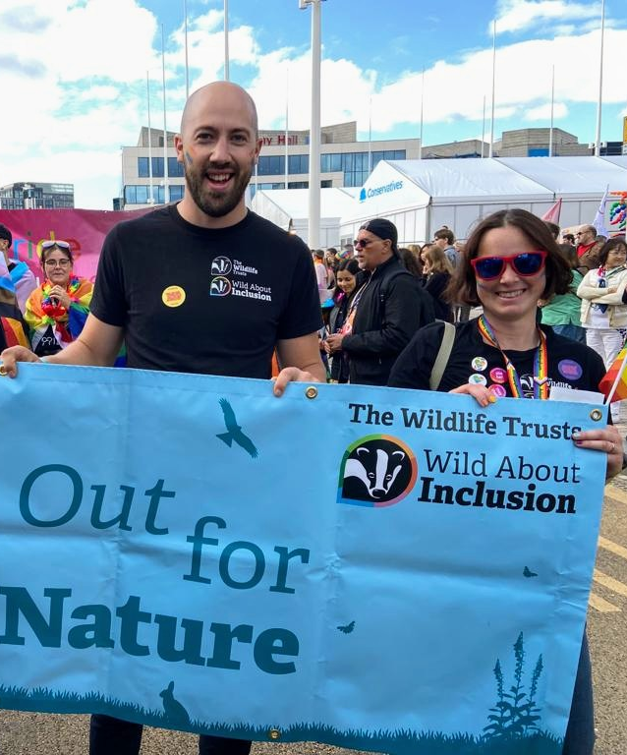
Key Responsibilities
Supporting communities to deliver action for nature
Support local organisers, volunteers to activate and connect diverse groups and coalitions around a shared vision for wildlife.
Co-develop and support regional or multi-village networks to act as platforms for connection, collaboration, and shared influence.
Mentor and train local leaders and volunteer organisers, helping them grow their confidence and capacity.
Organise events, awards, and recognition schemes that celebrate local leadership and impact.
Work with the Digital Organiser to enable online platforms and peer spaces that connect rural leaders across geographies.
Contribute to the development and delivery of training and peer learning through the Team Wilder Academy.

Slide 11
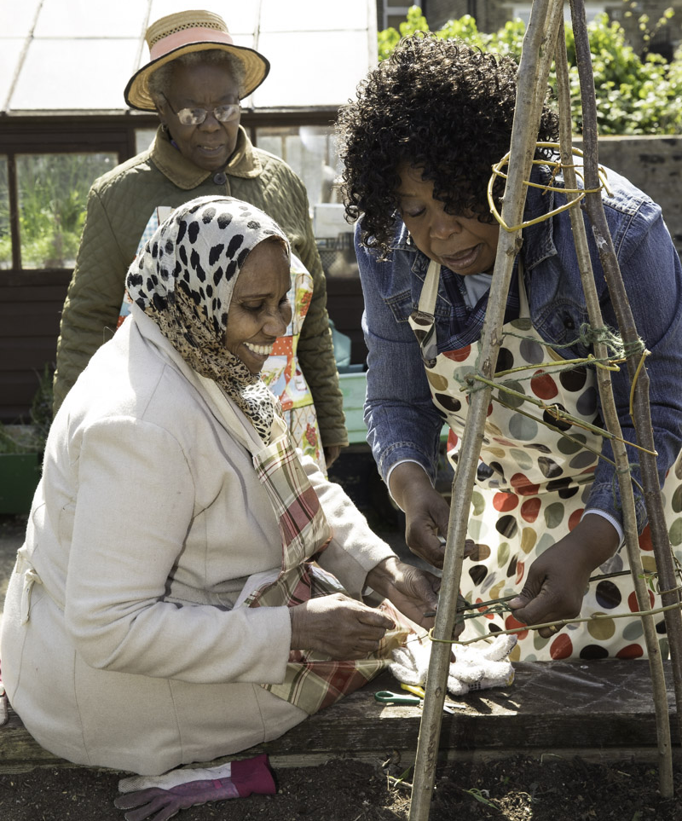
Key Responsibilities
Enabling grassroots influence and collective action
Support community leaders to co-design local campaigns, public actions, and placemaking projects.
Connect local grassroots action with wider campaign opportunities, ensuring local voices influence regional and national priorities.
Enable groups to explore collective influence through petitions, events, accountability meetings, and partnerships with decision-makers.
Share learning and coordinate strategic organising efforts across themes and places.
Amplify grassroots voices into wider Team Wilder strategies and campaigns.

Slide 12
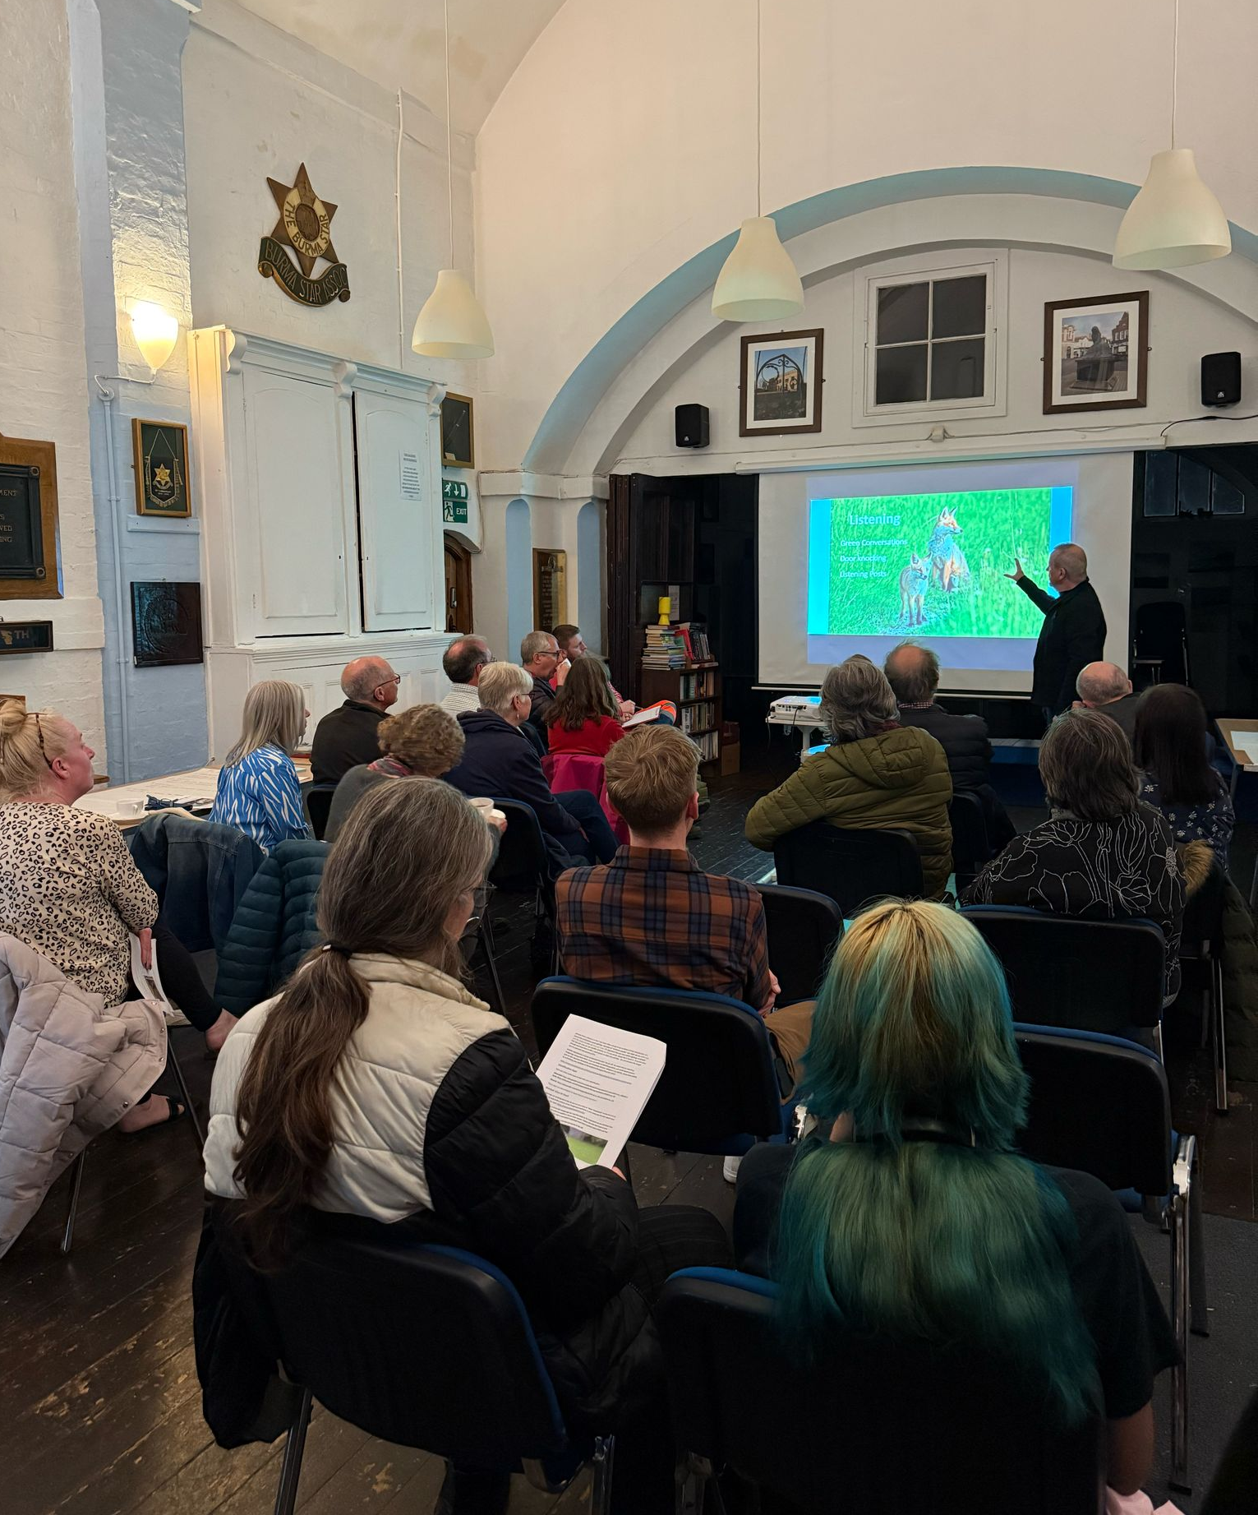
Specific skills, experience and attributes
What we are looking for:
We’re looking for someone who is passionate about people and communities, with experience of community organising or movement-building. You don’t need to be a nature or wildlife expert, what matters most is your ability to build relationships, support leaders and enable action to grow.
To succeed in this role, you’ll also need to be:
Able to build trust and relationships through, listening, empathy, respect and curiosity.
Confident mentoring, training, and coaching volunteer leaders and organisers.
Comfortable working across different geographies, often independently.
Proactive, flexible, and collaborative, with a focus on long-term impact.
Comfortable with uncertainty and complexity
Open to feedback, learning, and personal development.
Proactive, collaborative, and motivated to make things happen
Committed to equity, inclusion, and social justice.
We are especially keen to hear from candidates with experience working alongside underrepresented or marginalised groups.
Jon Hawkins

Slide 13
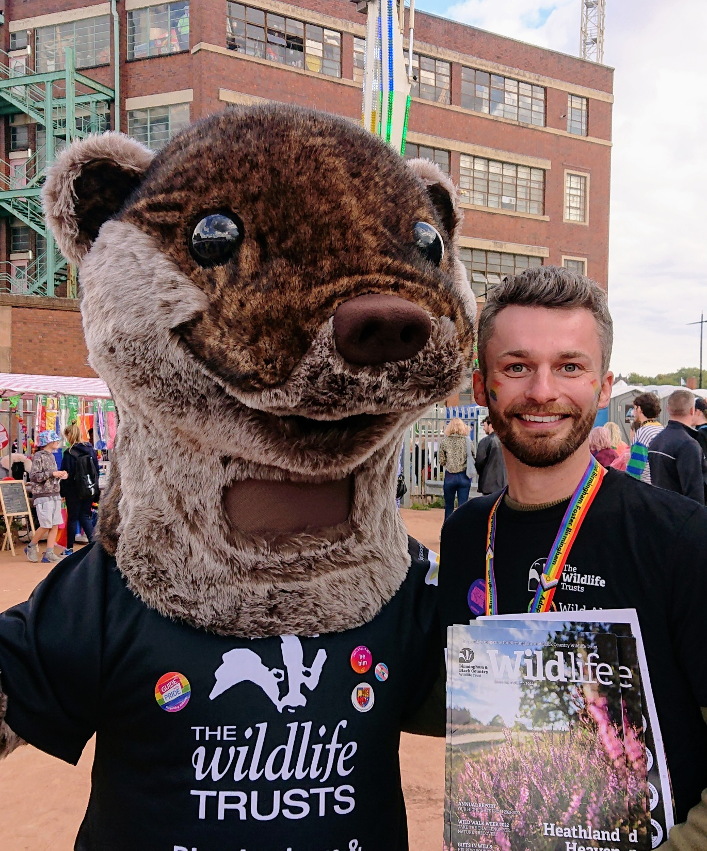
What we offer
Training, Support, and Continued Development
We are committed to ensuring that every Community Organiser is fully supported and are continuously developing their skills.
As part of this role, you will receive:
Regular coaching and supervision, helping you reflect on and improve your organising practice.
Continued training and development in community organising, movement building, and leadership.
Regular peer support opportunities, working alongside our community organising team locally across the Trust and the wider Federation of Wildlife Trusts.
Access to national training and practitioner networks through The Wildlife Trusts, Community Organisers Ltd, National Academy of Community Organisers and other community organising networks.
This role is an opportunity to develop as a leader in a people-powered movement, bringing key skills, knowledge and understanding to the movement and supporting us to implement and embed our regional and rural organising strategy.

Slide 14
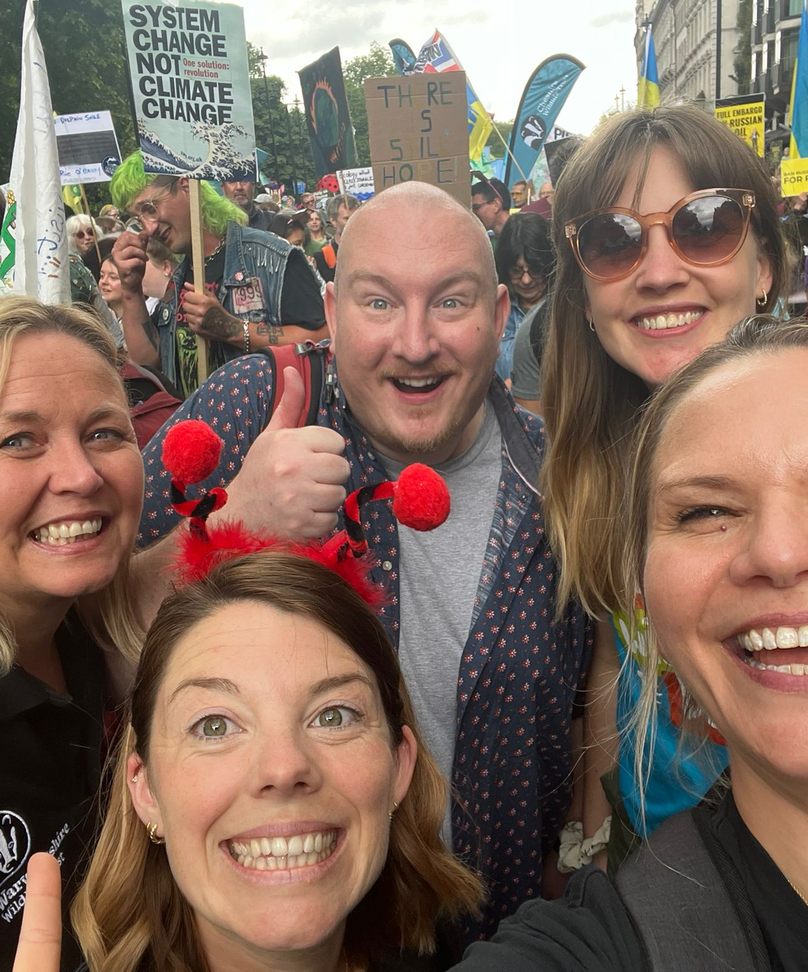
Job Specification
Accountable to: Community Organising Manager
Location: This is a broad-based role, working flexibly across Warwickshire, Coventry and Solihull. Desk-based activity can be carried out from home, our offices or community spaces.
Salary: Grade 2b, £25,353 - £34,694 depending on experience
Benefits:
Employers’ pension contribution up to 7% (with 4.5% from employee)
25 days holiday plus bank holidays per year
Access to Electric Vehicle salary sacrifice scheme
Employee Assistance Programme
Death in service benefit equivalent to 3x salary
Responsible for: Volunteer Organisers, Leaders and Champions.
Liaison with: Online and offline community groups, rural networks, local partners and collaborators
Hours: Full time, 35 hours - This role involves working flexibly, including some evenings and weekends to ensure that we are engaging inclusively with a range of stakeholders.
Contract: Permanent
Jon Hawkins

Slide 15
How to Apply
To help you show us your strengths, we encourage you to use the following headings when completing the “Knowledge, Skills, Experience and Personal Qualities” section of the application form. Please consider these headings in your response where possible, it makes it easier for us to understand your strengths and experience and helps ensure we assess every application fairly.
Community Organising experience - using community organising and movement building tools to develop activists, campaigns, community projects, or supporting others to lead change. Ability to develop and implement long-term digital organising plans that align with the broader movement goals.
Relationship-building – how you engage, build relationships and trust in the community and how you support and motivate a wide range of people to get involved.
Bringing people together – experience in creating or hosting events, spaces, or activities that help people connect.
Volunteer support or leadership – experience enabling or motivating others to step into leadership positions (including supporting volunteers or peer networks).
Facilitation or training – experience running workshops, delivering training, or supporting group learning in any setting.
Planning or strategic thinking – helping others set goals, develop plans, or organise in a structured way.
Social media, communications, or storytelling – using social media, community media, or creative tools to raise awareness, celebrate successes, or share stories.
Comfort with uncertainty, adaptability, and ability to stay organised – examples of how you stay flexible, grounded, or creative in fast-moving or unpredictable situations.
Commitment to equity, diversity, and inclusion – share how this shows up in your values, lived experience or how you approach working with others.
Passion for nature and wildlife - you don’t need to be an expert, just tell us why you care!
Monitoring, evaluation, and learning – ways you’ve captured feedback, measured impact, or adapted your approach based on what’s working.
ICT and compliance awareness – experience using MS Office or collaborative tools (e.g. Zoom, Canva), and awareness of safeguarding, health and safety and GDPR in community settings.
Jon Hawkins

Slide 16
